Slide 1

Getting Started with Xamarin.Forms Shapes
ALEJANDRO RUIZ
Microsoft MVP
Software Engineer @ ArcTouch

Slide 2

Life before Shapes
Simulated shapes using Forms controls. 😢 😢
Custom Renderers. 😩 😩
Third party packages(increasing the app size). 😡 😡
No native implementations. 😭 😭
@alejandroruizva

Slide 3
Starting with Shapes
Require to target Xamarin.Forms 4.7.
Is an experimental feature you’ll require to enable the “Shapes_Experimental” flag.
Contains prebuilt shapes definitions (line, ellipse, polyline, polygon & rectangle).
@alejandroruizva

Slide 4
Definition of the Shape class
Aspect: is used to define the way that the shape will filling the space (Fill, None, Uniform or UniformToFill).
Fill: from type Brush indicates the color pattern to paint inside the shape.
Stroke: from type Brush indicates the color pattern to paint the shape outline.
StrokeDashArray: represent the values to indicate the dashes and gaps that are used for shape outline.
StrokeDashOffset: specifies the distance where a dash begins.
StrokeLineCap: describes the start and end of a line of segment (Flat, Square or Round ).
StrokeThickness: indicates the width of a shape outline.
@alejandroruizva

Slide 5


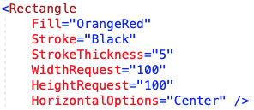

Rectangle
Allow to draw a rectangle/square by setting the Width, Height, Fill & Stroke for border if is required.
@alejandroruizva

Slide 6


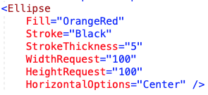
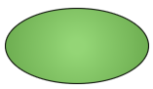
Ellipse
Allow to draw an ellipse/circle by setting the Width, Height, Fill & Stroke for border if is required.
@alejandroruizva

Slide 7


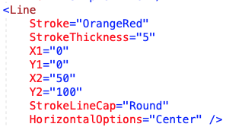

Line
Allow to draw lines by setting the position of point 1(X1 / Y1) and point 2(X2 / Y2) & Stroke brush / Thickness.
@alejandroruizva

Slide 8

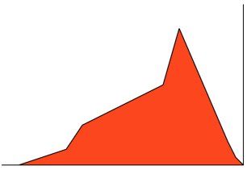
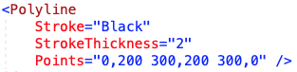
Polyline
Allow to draw a continue line by setting a collection of points & Stroke brush / Thickness.
@alejandroruizva

Slide 9


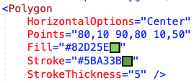
Polygon
Allow to draw multiple lines to create closed shapes & Stroke brush / Thickness.
@alejandroruizva

Slide 10


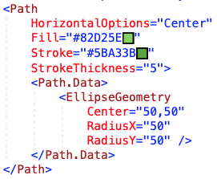

Geometries
Enable you to describe the geometry of a 2D shape. Geometry objects can be simple, such as rectangles and circles, or composite, created from two or more geometry objects.
@alejandroruizva

Slide 11

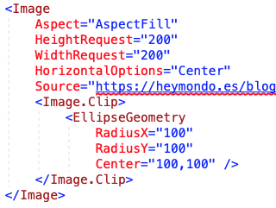

Clip with a Geometry
By using a geometry definition you’re able to clip any Xamarin.Forms View.
@alejandroruizva

Slide 12
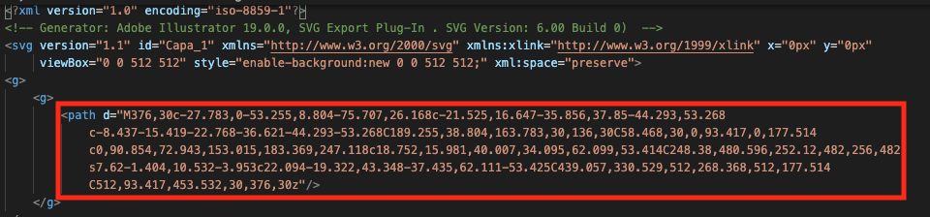
Using SVG
Shapes feature contains a helper that allows to use standard “Path” definitions from SVG files.
@alejandroruizva

Slide 13
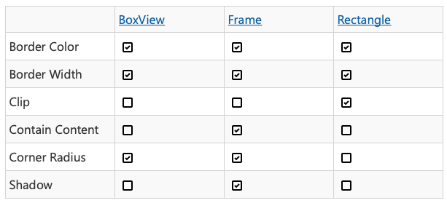
Usage Recommendations
@alejandroruizva

Slide 14




Get Inspired
@alejandroruizva

Slide 15

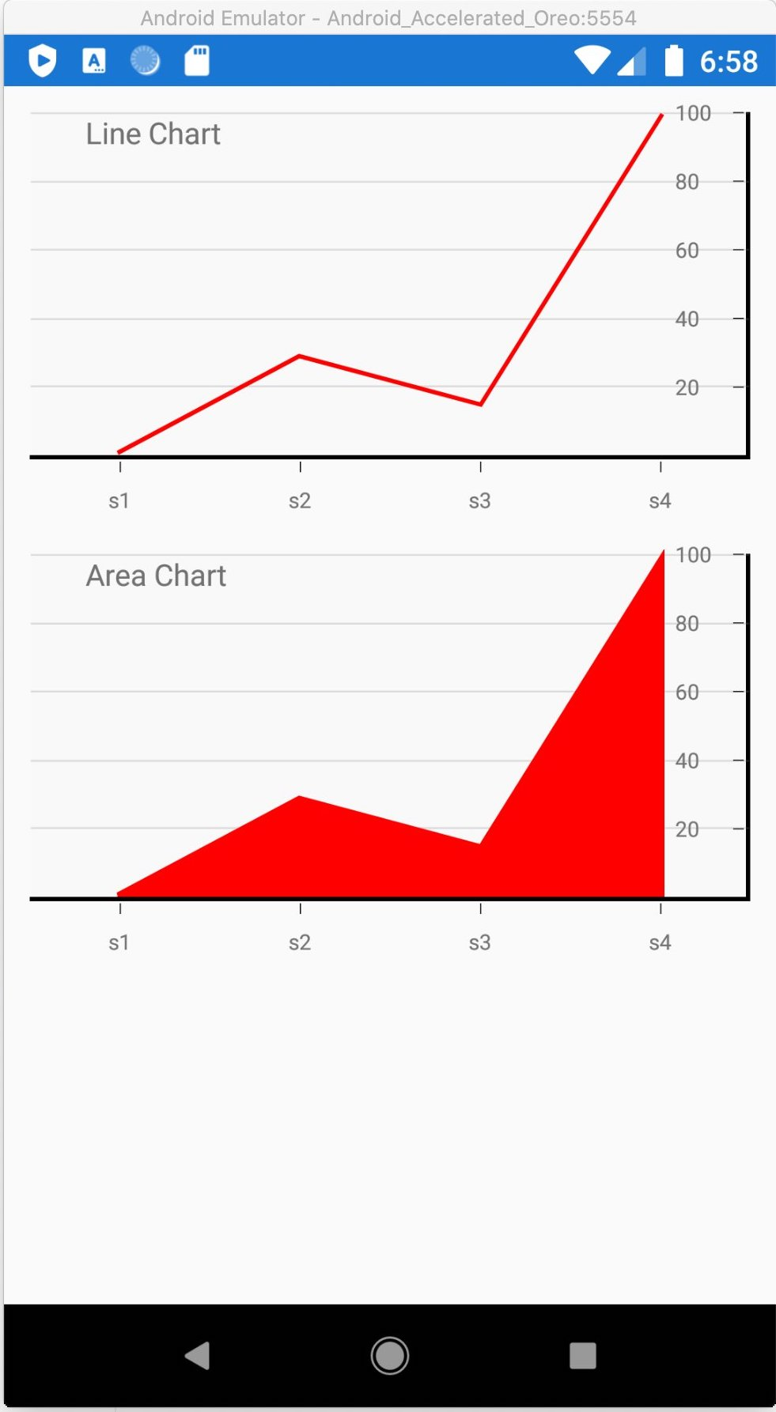

Get Inspired
@alejandroruizva

Slide 16
Resources
https://devblogs.microsoft.com/xamarin/xamarin-forms-shapes-and-paths/
https://docs.microsoft.com/en-us/xamarin/xamarin-forms/user-interface/shapes/
https://github.com/jsuarezruiz/xamarin-forms-goodlooking-UI
@alejandroruizva

Slide 17

OBRIGADO!
Questions?
Alejandro Ruiz
Microsoft MVP: Developer Technologies
Getting Started with Xamarin.Forms Shapes
DEMO: https://github.com/AlejandroRuiz/XamarinSummitLive2020
@alejandroruizva
https://alejandroruizvarela.blogspot.mx

